Slide 1



Building Cross Platform PowerShell Modules
Adam Driscoll
Software Architect @ STEALTHbits
Owner @ Ironman Software
@adamdriscoll

Slide 2
Agenda
Overview of PowerShell Core
Differences in Windows PowerShell and PowerShell Core
Tools and methods for working on different platforms
Testing modules using Docker instances
Basic Binary modules
A story of a complex binary module

Slide 3
A new era of PowerShell
January 19, 2018 – Release of PowerShell Core
Two flavors of our favorite little scripting language
Windows PowerShell
PowerShell Core
Dozens of new platforms to support
Windows and Windows IoT
OS X
Many Flavors of Linux
New CPU Architectures (ARM)

Slide 4
A golden age of incompatibility
Differences in the language
Differences in core cmdlets
Differences in core aliases (curl!)
Many missing modules in PowerShell Core
Different .NET runtimes
Different Installation Directories
Different PSModulePaths

Slide 5
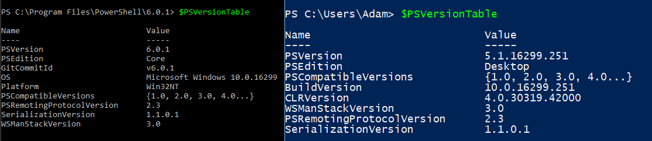
Identifying Differences
Handy Variables
IsCoreCLR
IsLinux
IsMacOS
IsWindows
PSVersionTable

Slide 6
Tools to help
WindowsPowerShellCompatibilityPack – Future home of all compatibility shims between Core and Windows
PSCoreWindowsCompat – Imports namespaces for missing .NET types (Active Directory!) into PS Core
WindowsPSModulePath – Sets the PSModulePath to include Windows PowerShell paths in PowerShell Core
PowerShim – Execute Windows PowerShell cmdlets from PowerShell Core

Slide 8
Modules – Rules to Live By
Understand which core cmdlets exist on which platforms
Understand which modules work on which platforms
Write cross platform automated tests
Choose your top platforms to support

Slide 9
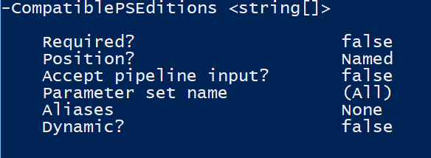
Module Manifests
CompatiblePSEdtions (PS v5.1 and up)
ProcessorArchitecture
Tags

Slide 10
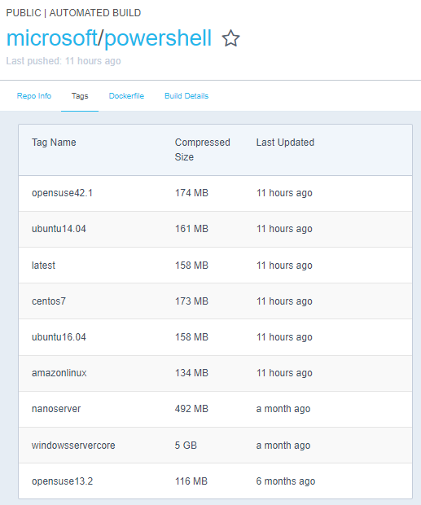
Using Docker for Cross Platform Testing
Microsoft has Docker Hub images for all your favorite flavors
Notes:
https://blogs.technet.microsoft.com/heyscriptingguy/2017/10/03/use-docker-to-automate-testing-of-powershell-core-scripts/
https://github.com/DTW-DanWard/PowerShell-Beautifier/tree/master/test/Automation
Dan Ward

Slide 12
Understanding .NET Core
Windows PowerShell
PowerShell Core
.NET Framework
.NET Core
.NET Standard Library

Slide 13
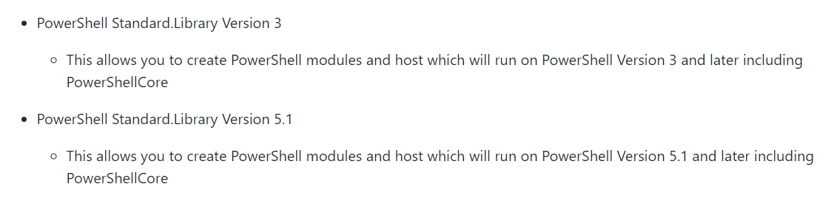
Building for .NET Standard
PowerShell Standard Library

Slide 14
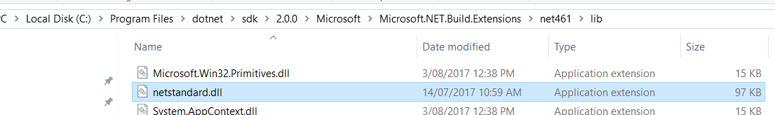
Deployment
Include PowerShell scripts
Include Binaries
Include netstandard.dll
Include any .NET Standard DLLs that you reference

Slide 16
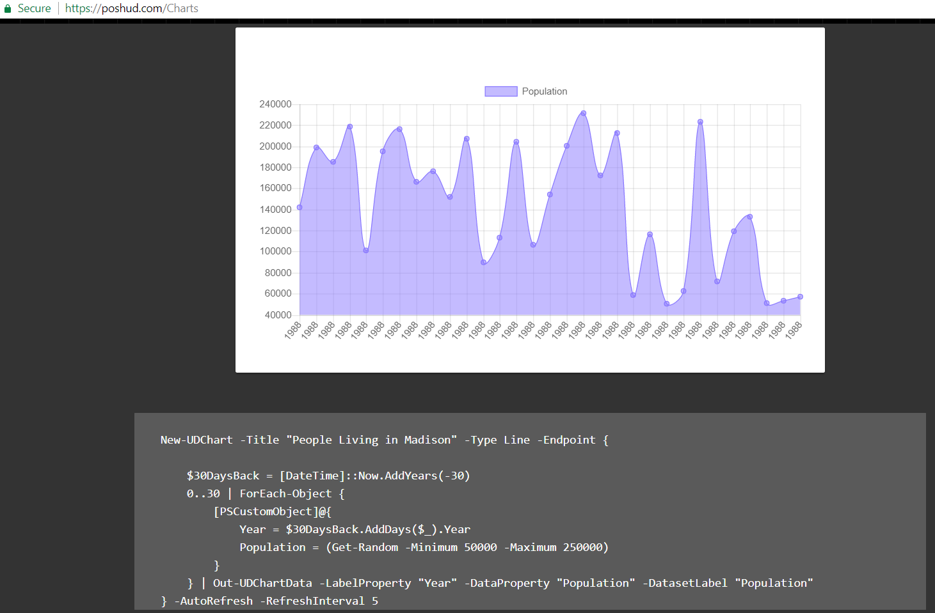

Slide 17
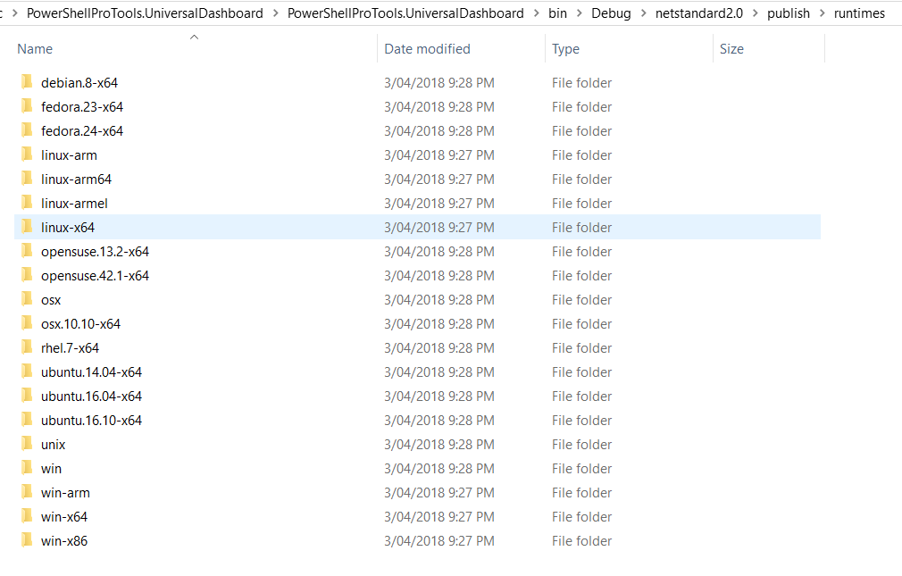
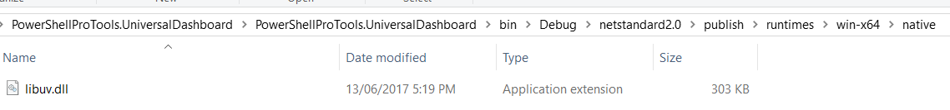
Native Binaries
Dotnet publish will product deployment folders
Native binaries found in Runtime directory
Binaries will not automatically be loaded by PowerShell at runtime

Slide 18
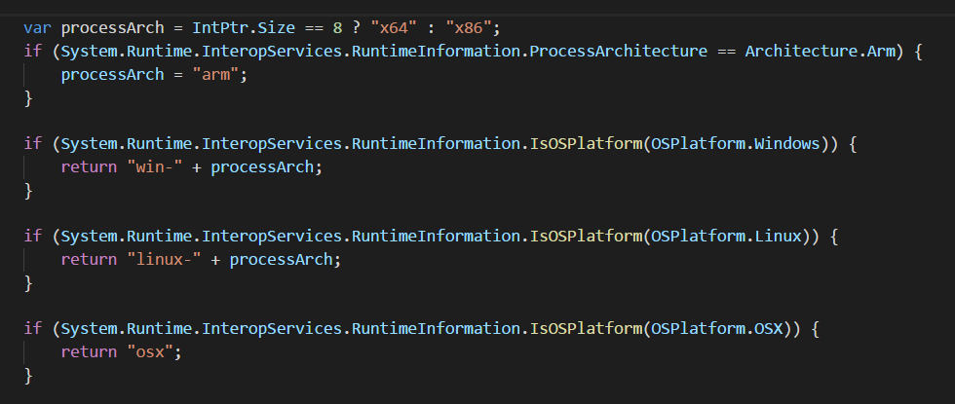

Slide 19
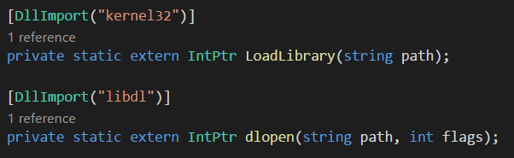

Slide 20
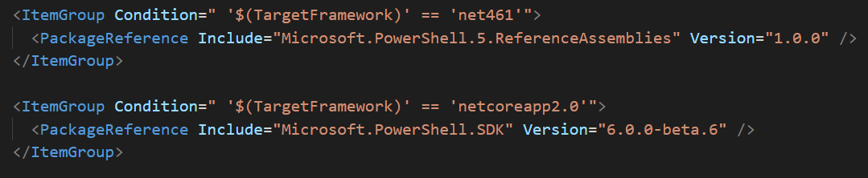

Slide 21
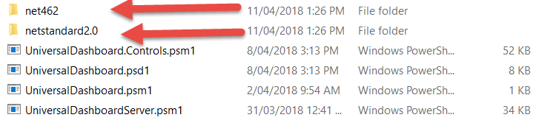

Slide 22
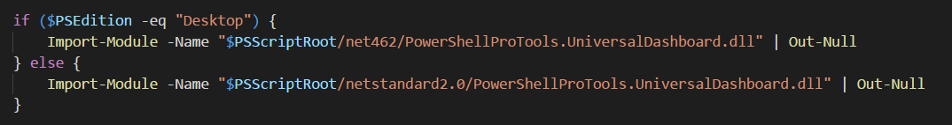

Slide 23
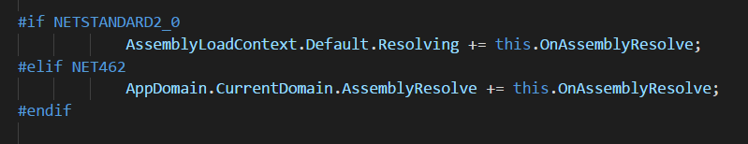

Slide 24
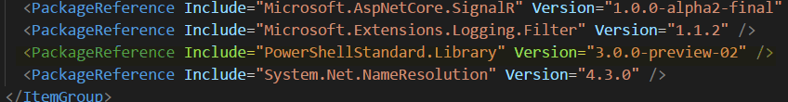

Slide 25
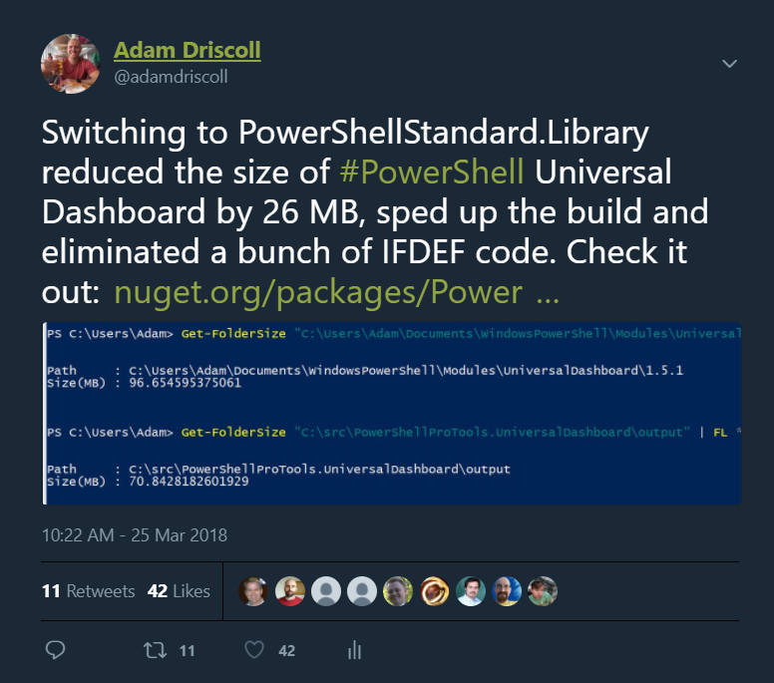

Slide 26
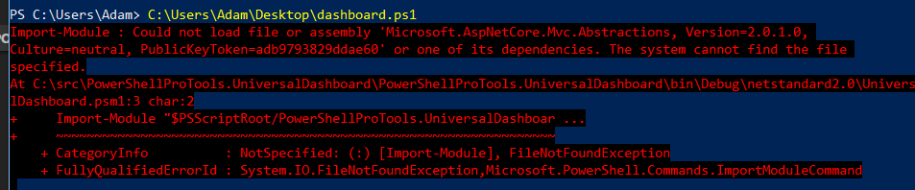

Slide 28
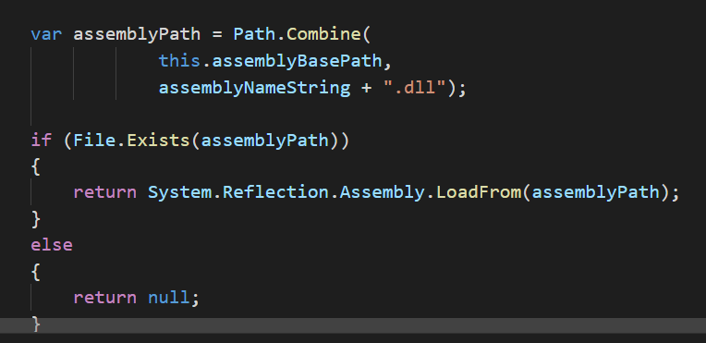

Slide 29
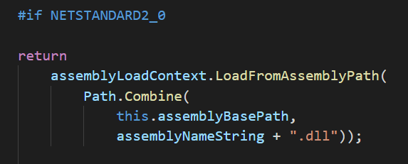

Slide 30
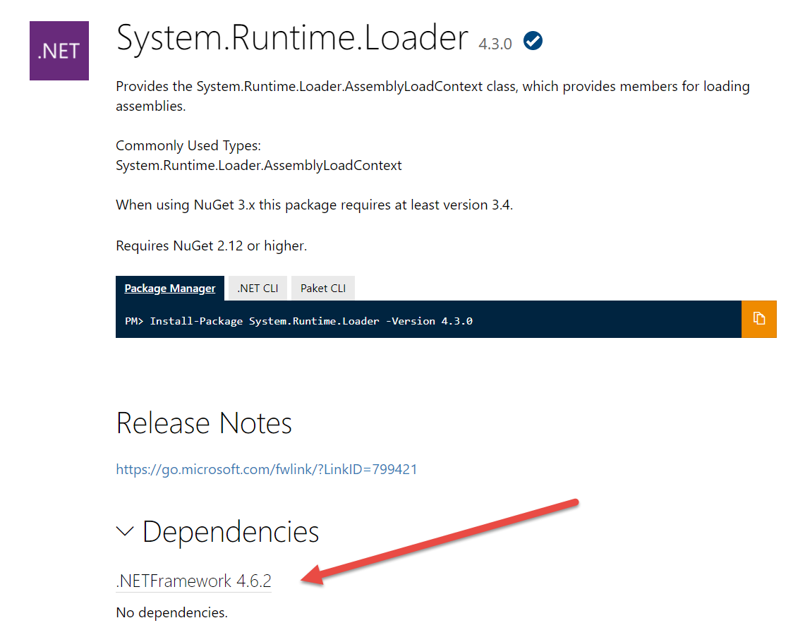

Slide 32
Caveats
Not all binaries are compatible (even if they are “.NET Standard”)
System.Runtime.Loader! ;(
Native binaries must be included for each platform (RID)
Native binaries must be loaded by hand
Can’t reference anything but .NET Standard
Assembly resolution ☹

Slide 33
Calls to action
Use PowerShellStandard.Library when appropriate
Cross-platform testing is key
Dictate what you support in your manifest to avoid problems

Slide 34
Thank you!
Follow me on Twitter: @adamdriscoll
Fork me on GitHub: adamdriscoll
Check out PowerShell Pro Tools and Universal Dashboard: ironmansoftware.com

